Slide 1
Design Patterns
Unit 08
Builder Pattern

Slide 2
Objectives
In this lesson, you will learn to:
Builder Pattern (Creational Pattern)
  Separate the construction of a complex object from its representation so that the same construction process can create different representations.

Slide 3
The Builder Method Pattern
Intent
  Separate the construction of a complex object from its representation so that the same construction process can create different representations.

Slide 4
The Builder Method Pattern
Motivation
  Some programs construct menus dynamically based on the context of the data being displayed.
  A reader for the RTF (Rich Text Format) document exchange format should be able to convert RTF to many text formats. The reader might convert RTF documents into plain ASCII text or into a text widget that can be edited interactively. The problem, however, is that the number of possible conversions is open-ended (开放式的/无限制的). So it should be easy to add a new conversion without modifying the reader.

Slide 5
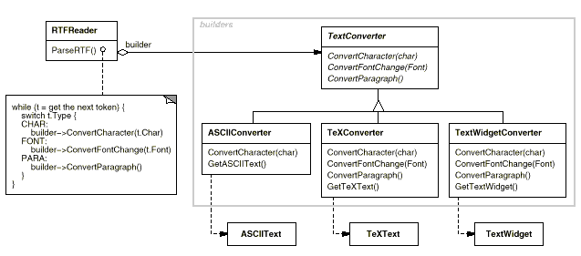
The Builder Method Pattern Example 1

Slide 6
The Builder Method Pattern
Applicability
  The algorithm for creating a complex object should be independent of the parts that make up the object and how they are assembled.
  The construction process must allow different representations for the object that’s constructed.

Slide 7
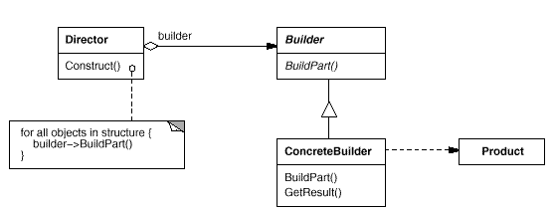
The Builder Method Pattern
Structure

Slide 8
The Builder Method Pattern
Participants
  Builder → TextConverter
    specifies an abstract interface for creating parts of a Product object ConcreteFactory
  ConcreteBuilder → ASCIIConverter, TeXConverter, TextWidgetConverter
    constructs and assembles parts of the product by implementing the Builder interface
    defines and keeps track of the representation it creates
    provides an interface for retrieving the product
  Director → RTFReader
    constructs an object using the Builder interface
  Product → ASCIIText, TeXText, TextWidget
    represents the complex object under construction. ConcreteBuilder builds the product's internal representation and defines the process by which it's assembled
    includes classes that define the constituent parts, including interfaces for assembling the parts into the final result

Slide 9
The Builder Method Pattern
Collaborations
  The client creates the Director object and configures it with the desired Builder object.
  The Director notifies the builder whenever a part of the product should be built.
  The Builder handles requests from the director and adds parts to the product.
  The Builder returns the product to the client

Slide 10
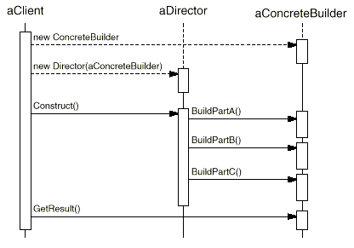
The Builder Method Pattern
The following interaction diagram illustrates how Builder and Director cooperate with a client.

Slide 11
The Builder Method Pattern
Consequences
  It allows the client to vary a product’s internal representation with minimum work
  It improves modularity by isolating code for construction and representation
  It allows the developer finer (出色地) control over the construction process. Unlike creational patterns that construct products “in one shot” (一次性), this pattern constructs the product step by step under the director’s control.

Slide 12
The Builder Method Pattern Example
Builder →TextConverter
  abstract public class TextConverter {
  public void convertCharacter(char c){ … }
  public void convertParagraph(){ …}
  public abstract ASCIIText getResult() ;
  }

Slide 13
The Builder Method Pattern Example
The ConcreteBuilder classes → ASCIIConverter
public class ASCIIConverter extends TextConverter {
  private ASCIIText asciiTextObj;
  //resulting product converts a character to target representation and
  //appends to the resulting
  public void convertCharacter(char c) {
  char asciiChar = new Character(c).charValue();
  //gets the ascii charcter
  asciiTextObj.append(asciiChar);
  }
  public void convertParagraph(){}
  public ASCIIText getResult() {
  return asciiTextObj;
  }
}

Slide 14
The Builder Method Pattern Example
The Director → RTFReader
  public class RTFReader
  {
  public static final char EOF=‘0’; // Delimitor (定界符) for End of File
  public final char CHAR='c';
  public final char PARA='p';
  private char t;
  private TextConverter builder;
  /** @link dependency */
  /*#Document lnkDocument;*/
  public RTFReader(TextConverter obj) {
  builder=obj;
  }

Slide 15
The Builder Method Pattern Example
The Director→ RTFReader
public void parseRTF(Document doc) {
  while ((t=doc.getNextToken())!= EOF) {
  switch (t) {
  case CHAR: builder.convertCharacter(t);
  case PARA: builder.convertParagraph();
  }
  }
  }
}

Slide 16
The Builder Method Pattern Example
The client
  public class Client {
  private RTFReader rtfReader ;
  /** @link dependency */
  /*#ASCIIConverter lnkASCIIConverter;*/
  public void createASCIIText(Document doc) {
  TextConverter asciiBuilder = new ASCIIConverter();
  rtfReader = new RTFReader(asciiBuilder);
  rtfReader.parseRTF(doc);
  ASCIIText asciiText = asciiBuilder.getResult();
  }
  public static void main(String[] args) {
  Client client=new Client();
  Document doc=new Document();
  client.createASCIIText(doc);
  System.out.println("This is an example of Builder Pattern");
  }
  }

Slide 17
The Builder Method Pattern Example
  public class Document {
  private static int value;
  private char token;
  private static int counter = 0 ;
  public Document() {
  counter = 0 ;
  }
  public char getNextToken() {
  //Get the next token
  if ( counter++ != 10)
  return token;
  else
  return RTFReader.EOF;
  }
  }

Slide 18
The Builder Method Pattern Example
  public class ASCIIText {
  public void append(char c) {
  //Implement the code here
  }
  }

Slide 19
The Builder Method Pattern Example
Related Patterns
  Abstract Factory is similar to Builder in that it too may construct complex objects. The primary difference is that the Builder pattern focuses on constructing a complex object step by step. Abstract Factory's emphasis is on families of product objects (either simple or complex). Builder returns the product at a final step, but as far as the Abstract Factory pattern is concerned, the product gets returned immediately.
  A Composite is what the builder often builds

Slide 20
Summary
In this lesson, you learnt:
Builder Pattern
  Separate the construction of a complex object from its representation so that the same construction process can create different representations.

